Slide 1
Slide 1
Idea and Inspiration
Data Ingestion and Wrangling
Computation and Analysis
Modeling and Feature Selection
Reporting and Visualization
Conclusion and Q&A
“Should I Stay or Should I Go?” Applying Machine Learning to the FEVS to Predict
Federal Employee Intent to Leave
Chuanfeng “Joy” Wu
Jennifer Ziegler
Georgetown University Data Science Certificate Cohort 27
September 24, 2022
Notes:
Good morning everyone my name is Jennifer Ziegler and my partner Joy Wu and I are Team Stay or Go. Today we will take you on our journey through the data science pipeline with the Federal Employee Viewpoint Survey ~or "FEVS”~ where we used machine learning to predict employees expressed intention to leave the federal workforce.

Slide 2
Idea and Inspiration
Notes:
We'll start with a discussion about where we got the idea for this project

Slide 3
Project Aspirations
Idea and Inspiration
Our group initially had three members
Two of worked for the federal government
One for the Department of Labor
Third had expertise in organizational communication
We all wanted to work with a tabular data set
We all had a goal to learn Python
→ We chose to work with data from the Federal Employees Viewpoint Survey (FEVS)
Notes:
The idea to study the FEVS came from our former group member Michael Kim who brought this idea to our group. His agency was interested in understanding more about why people leave the federal service, or conversely what makes people stay. We all knew we wanted to work with a tabular data set and we thought that the FEVS would give us a good opportunity to learn Python and other elements of machine learning while answering a practical question.

Slide 4
“FEVS”
Idea and Inspiration
Conducted annually by the Office of Personnel Management (OPM)
On average, each spring from 2016-2020:
About 80 federal agencies participated
About 1.25M employees were invited to participate
About 100 questions were asked
About 500K responded, for a 44% response rate
Governmentwide and agency reports issued each fall
Except for 2020 when survey distribution and tabulation were delayed 6 months due to the pandemic
“an organizational climate survey that assesses how employees jointly experience the policies, practices, and procedures characteristic of their agency and its leadership” -OPM
Notes:
The federal Office of Personnel Management or OPM invites all US government employees to participate in the FEVS every year. The OPM describes the FEVS as an organizational climate survey that assesses how employees experience their agency and its leadership. For this project we studied the years 2016 to 2020.

Slide 5
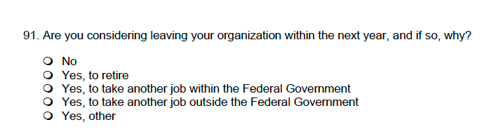
We focused on one question that asked about an employee’s intent to leave within the next year:
Idea and Inspiration
Initial Hypothesis: By analyzing the FEVS data using Machine Learning, we will identify the factors that can predict someone answering “Yes, to take another job outside the Federal Government” to this question (i.e., “Leave”).
Notes:
To examine why employees would decide to leave or stay we focused on one particular question that is asked every year but that is not necessarily analyzed in any formal way each year. The question is: "are you considering leaving your organization within the next year and if so why?" As you can see from our hypothesis we were interested in analyzing FEVS data using machine learning to identify the factors that would predict someone answering yes to that third option, to take another job outside the federal government. We nicknamed this option "leave."

Slide 6

Some of us also remembered a similarly titled Clash song from the 80s…
Idea and Inspiration
“Should I Stay or Should I Go, Now?” – The Clash
➔ And so we became “Team Stay or Go”
Notes:
I dare say it was also one of our goals to have a little bit of fun with this project. And the more we talked about the decision to stay or the decision to go the more we were reminded of the 80s song by the clash "should I stay or should I go now?" and so we affectionately nicknamed ourselves "team stay or go."

Slide 7
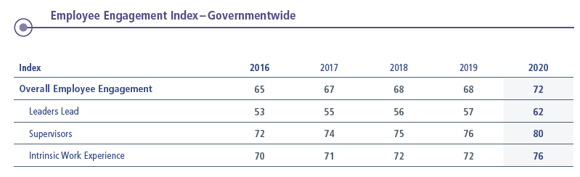

The OPM collected certain questions into “Indexes” and tracked trends each year
Idea and Inspiration
Employee Engagement Index (EEI):
15 questions
Three categories
Also:
NIQ (New Inclusion Quotient)
AES (Annual Employee Survey mandated by Congress)
Global Satisfaction Index (GSI):
4 questions
Notes:
On a more serious note. We wanted to introduce something called "Indexes" that the OPM used every year to collect responses to certain questions in a numeric score so that they could track trends in those indicators every year. Two that are important for our study are the employee engagement index ~or EEI~ and the global satisfaction index ~or GSI~. We also wanted to introduce the annual employee survey at lower right. The AES is not exactly an index but it is a collection of 16 questions that are federally mandated by Congress to be asked of all employees each year. So no matter what else is included in the FEVS every year, those 16 questions must be there, according to Congress.

Slide 8
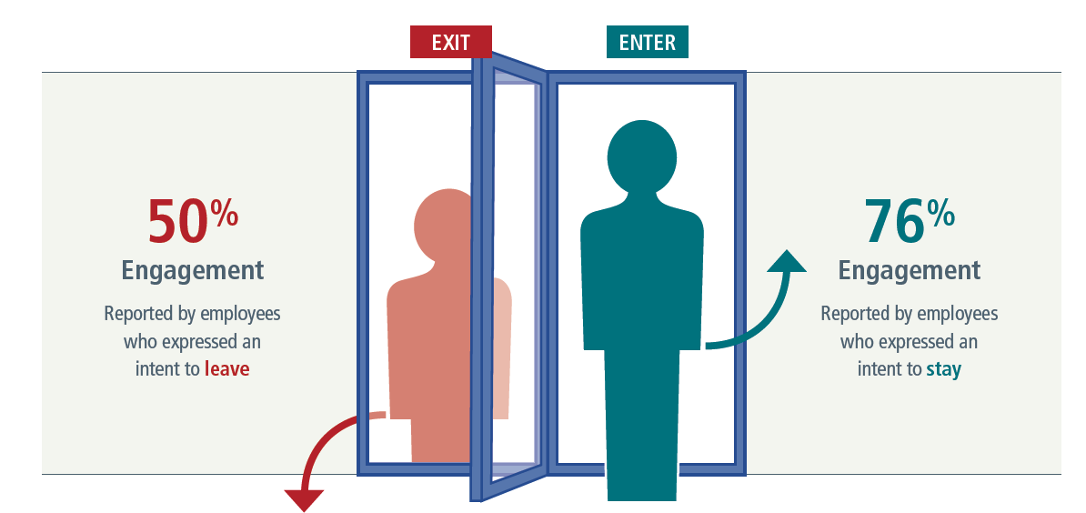

Idea and Inspiration
OPM twice used the Indexes to analyze Intent to Leave:
Once in 2016 (EEI):
And again in 2018 (EEI):
(In 2021, after the time period for our analysis, the OPM also associated Intent to Leave with low GSI scores.)
Notes:
So here is why we are interested in the EEI and the GSI. I mentioned earlier that the intent to leave question is asked every year but it's not necessarily called out in the OPM's annual report every year. We found two exceptions. First, in 2016, when the OPM first introduced the EEI they pointed out that EEI scores were lower among employees who expressed intent to leave and higher among those who expressed intent to stay. They repeated this claim again in 2018. I should also say that after the time period for our analysis, in 2021 the OPM associated intent to leave with low GSI scores.

Slide 9
“What proportion of people answered ‘Leave’?”
FEVS 2016-2020, according to our analysis
Idea and Inspiration
We compared Intent to Leave to the BLS “Quits” Rate:
At the Height of the Great Resignation (Dec 2021):
3.6%
All Sectors
2.9%
0.7%
Federal Government Employees
According to our analysis of the survey data
During the time period of the survey:
All FGE
May 2016 2.0% 0.4%
May 2017 2.2% 0.4%
May 2018 2.5% 0.5%
May 2019 2.3% 0.5%
Sept 2020 2.3% 0.6%
“Is that a lot or a little?”
Source: Bureau of Labor Statistics Job Openings and Labor Turnover Survey
“JOLTS” at https://www.bls.gov/news.release/archives/jolts_02012022.pdf
Notes:
Now at the start, we wondered to what extent turnover is actually a problem for the federal government? So initially we did a quick analysis to see what is the proportion of people that answer leave. We calculated it at 3.6%. Still, not having much context for this number, we wondered if that was a lot or a little. So we decided to compare intent to leave to the Bureau of Labor Standards "Quits" rate.
The quits rate is the number of quits during the entire month as a percent of total employment.
You might remember that the time period in the middle of the pandemic was called the great resignation because people were quitting their jobs in record numbers. In December 2021, the BLS recorded the highest quits rate ever at 2.9%. That same month federal employees quit their jobs at a rate of 0.7%. We went back to the time period for the survey and we noticed that federal employees quit their jobs at even lower rates from 2016 to 2020.
As we look at these numbers we see that not only do federal employees quit their jobs at a rate lower than people in other sectors, but the fact that employees are answering this question at higher proportion than they actually quit may mean that this question may measuring something other than Intent to Leave. Like, perhaps it is measuring distress. So even though turnover might not necessarily be as large a problem for the federal government as compared to other industries, we thought this was still a worthy question to study. Perhaps an employee's expression of intent to leave could represent an intervention opportunity for federal managers if they were to receive the data in a timely way.

Slide 10
Project Goals
Idea and Inspiration
Primary:
Use Machine Learning to analyze the FEVS and identify the factors that predict an employee choosing “Leave” on the Intent to Leave Question
Secondary:
Validate (clarify/debunk) any assumed relationship between the Indexes and answers on Intent to Leave question
Develop a Web Survey or App that could allow federal managers to predict workforce availability (sooner), or even intervene
Notes:
This brings us to our overall project goals. First, as noted, we wanted to use machine learning to analyze the FEVS to identify the factors that predict an employee selecting leave on the intent to leave question.
Secondarily, we wanted to validate any assumed relationship between the Indexes and employee answers on the intent to leave question.
Finally if we had time we thought we could develop the web survey or an app that could allow federal managers to ask a few key questions to predict future workforce availability and even have an opportunity to intervene depending on the results.

Slide 11
Data Ingestion and Wrangling
Notes:
In the section we will talk about how we ingested the data for our analysis

Slide 12
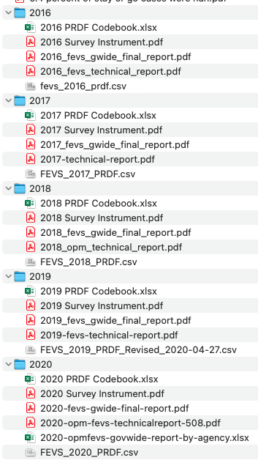
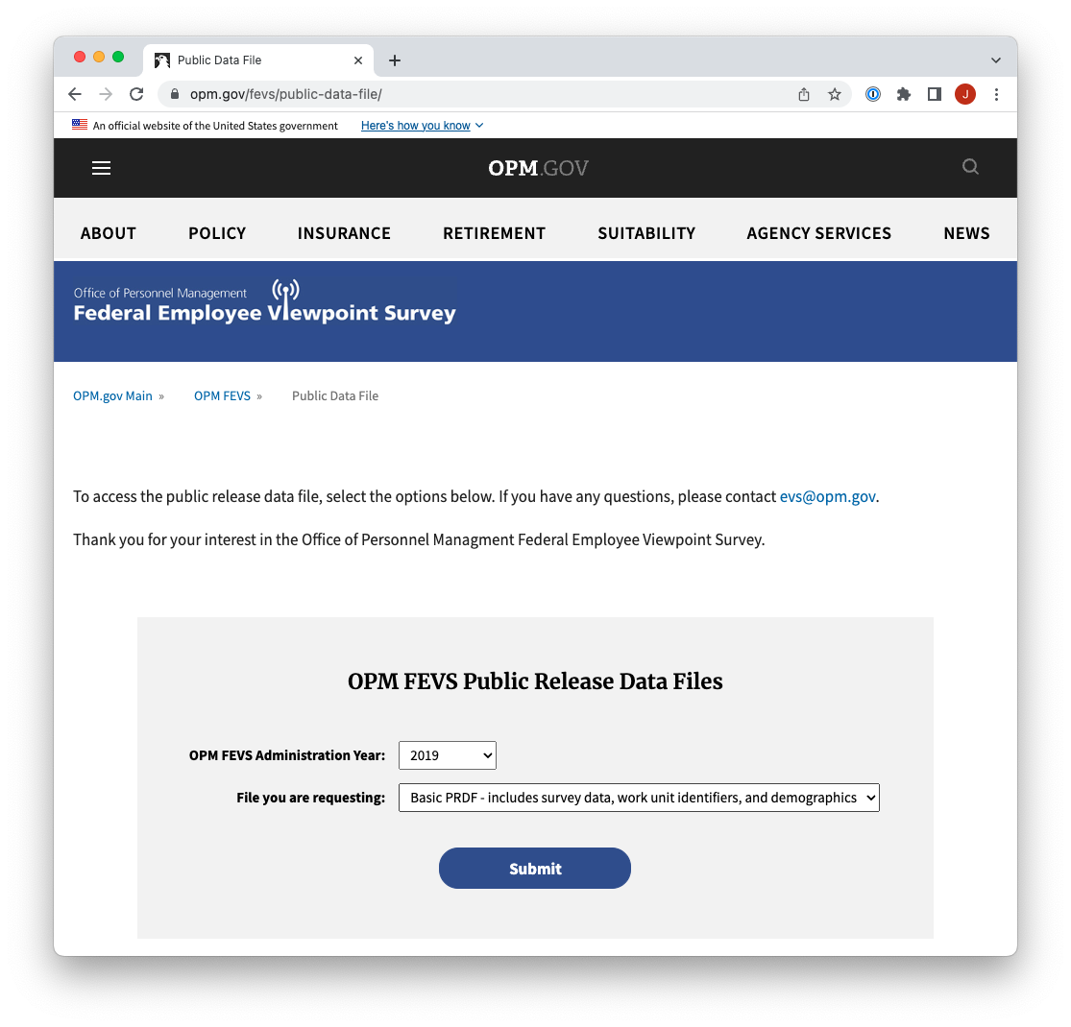
Data Ingestion
We downloaded Public Data files (.csv) for 2016, 2017, 2018, 2019, and 2020
We also downloaded government-wide reports, technical reports, and codebooks to add context.
Notes:
We downloaded public data files for 2016 through 2020 from the OPM website, where we also accessed annual reports, technical reports and code books that help to add context for the files.

Slide 13
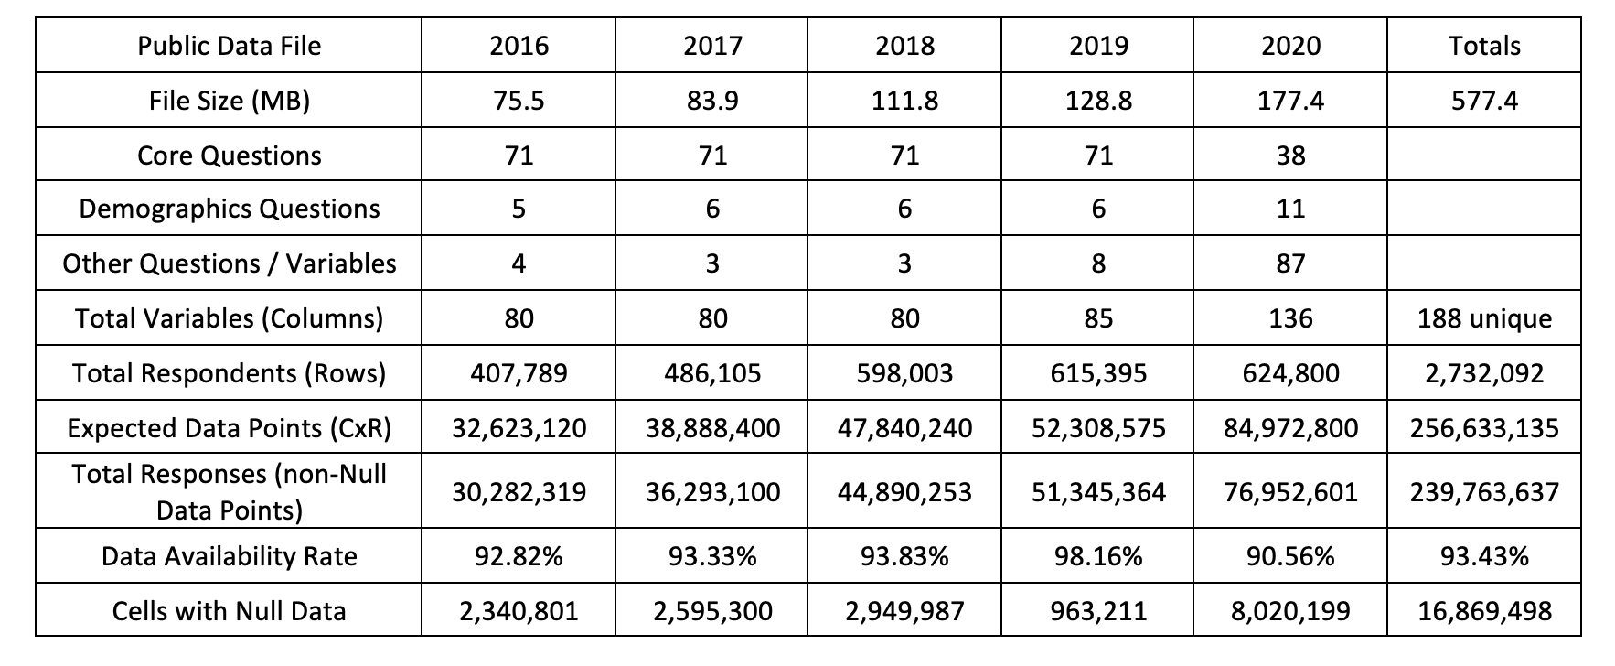
Data Features
Data Ingestion
Notes:
For the first three years of the survey the data were very similar with 71 core questions and a few other questions bringing the total variables to 80 for each year. But in 2019 and 2020 they OPM changed the FEVS survey dramatically. In 2019 it was changed to ask questions about employee experience of the government shut down that happened that year. And then in 2020 the FEVS was changed to ask questions about employee experience during the pandemic. If you notice, the core questions were scaled back to 38 in 2020 when 87 total other questions were asked. All told, from 2016 to 2020 there were 188 unique questions asked across all five years. We checked, and there were only 41 questions that were asked in 2016 that were still asked in 2020. All told, there were 2.7 million respondents over the years. So we were working with 239 million data points in about a half a gig of CSV files.

Slide 14
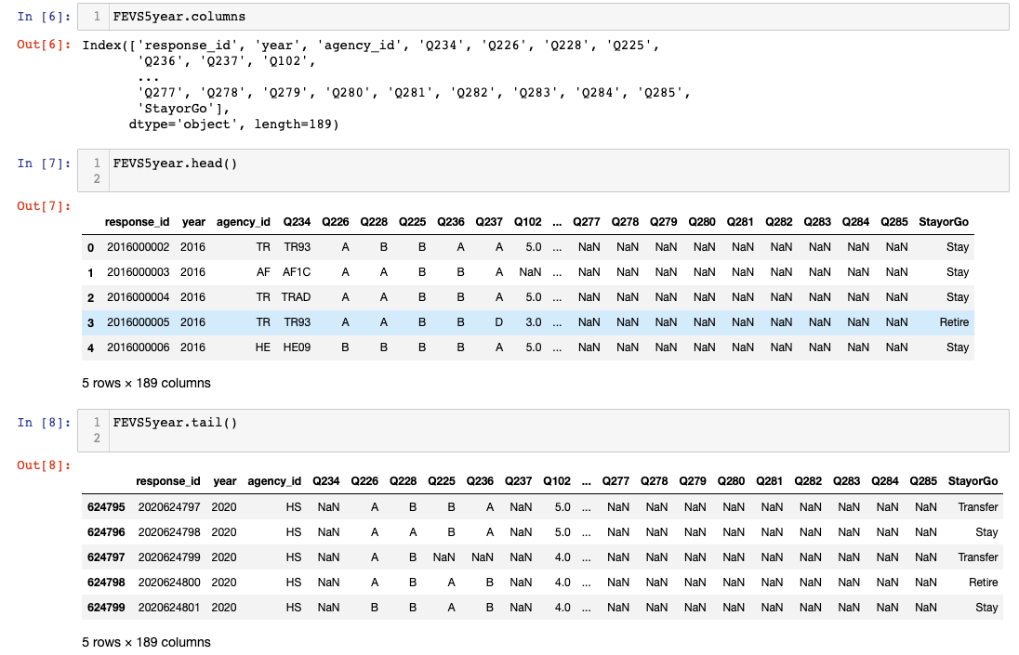
Early on, we decided to combine all questions from all years
Data Wrangling
We collected all Intent to Leave responses in one column: ‘Stay or Go’: Stay, Transfer, Retire, or Leave.
This brought our column total to 189.
Notes:
Early on, at the advice of our professors we decided not to drop any data but rather to combine all questions from all years, even if this meant that we would be working with a lot of null values. Because intent to leave was asked differently in different years we collected all of those responses into one column and we label the responses stay retire transfer or leave. This brought our column total to 189 going into early data analysis.

Slide 15

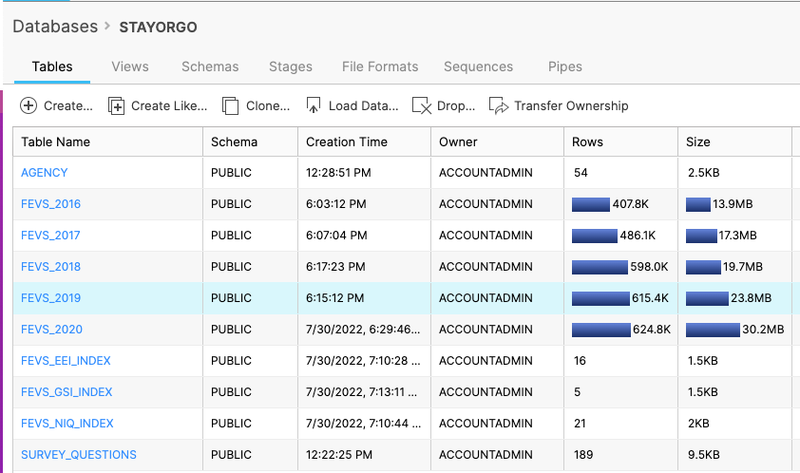
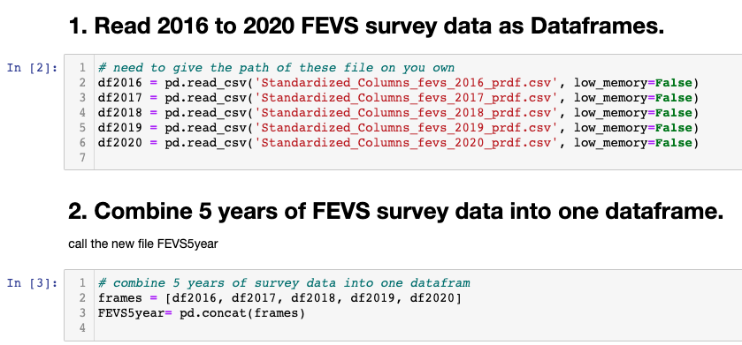
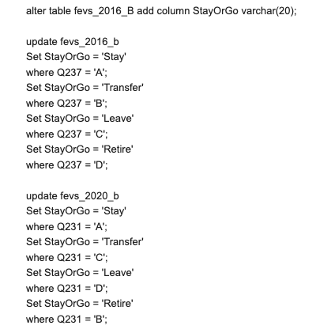
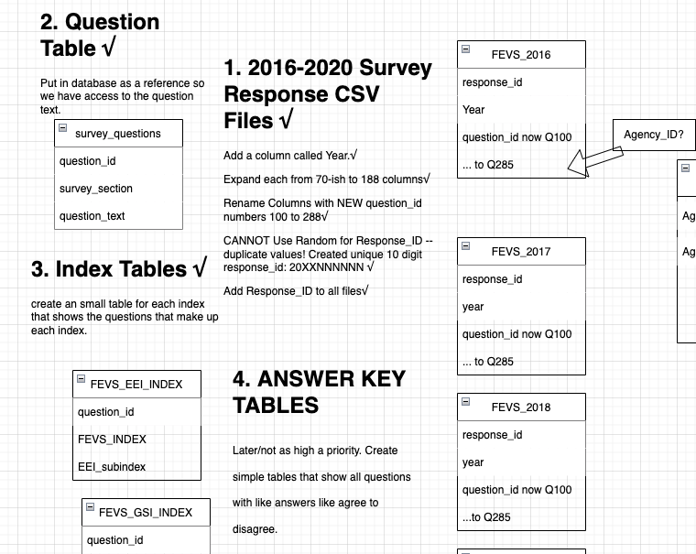
We created a Snowflake SQL database for WORM storage
Data Wrangling
But after our columns were standardized,
we mainly worked with CSV files.
Notes:
Because we were working with a large dataset we created an SQL database in snowflake for warm storage. On the left you can see an early table map, a sample script, and even a screenshot of the data after we loaded it into the system. However after we standardized the columns in our CSV files we found that we mainly worked with the underlying CSV files in our Jupiter notebooks. So the Snowflake database was a great experience to set up and to learn about SQL, but in this project we found that we didn't really use it.

Slide 16
Computation and Analysis
Notes:
Now I will turn it over to Joy who will talk about our early data analysis

Slide 17
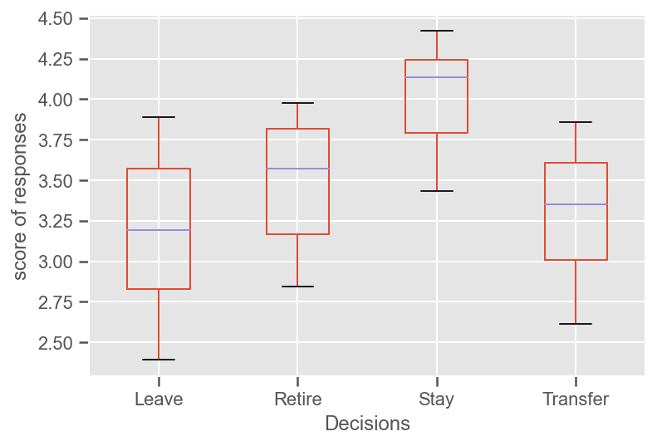
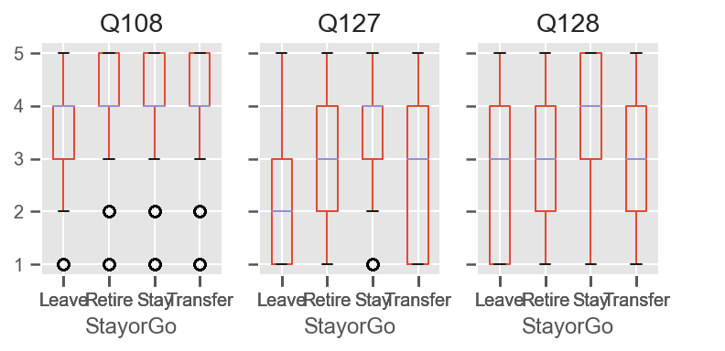
In early exploratory data analysis (EDA), we found “Leave” to be correlated with low EEI scores
Computation and Analysis
On average, employees expressing “Leave” scored lower on EEI questions than those intending “Stay.”
“Leave” responses to Q108, Q127, and Q128 were especially striking.
Q108 = I know how my work relates to the agency's goals.
Q127 = In my organization_ senior leaders generate high levels of motivation and commitment in the workforce.
Q128 = My organization's senior leaders maintain high standards of honesty and integrity.
EEI= Employee Engagement Index

Slide 18
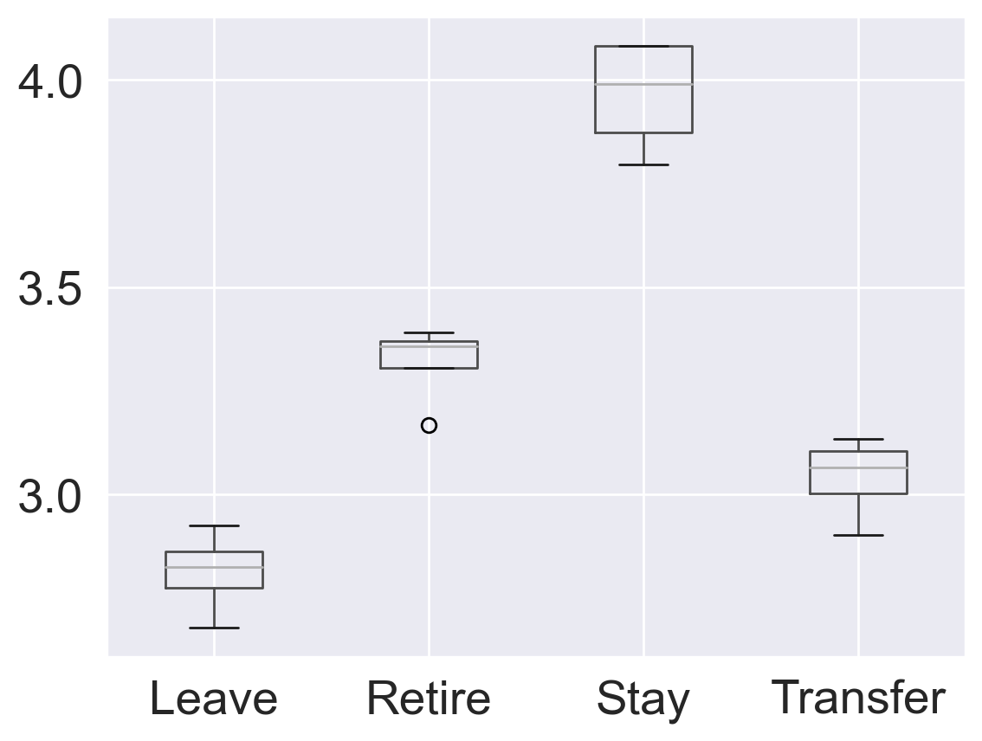
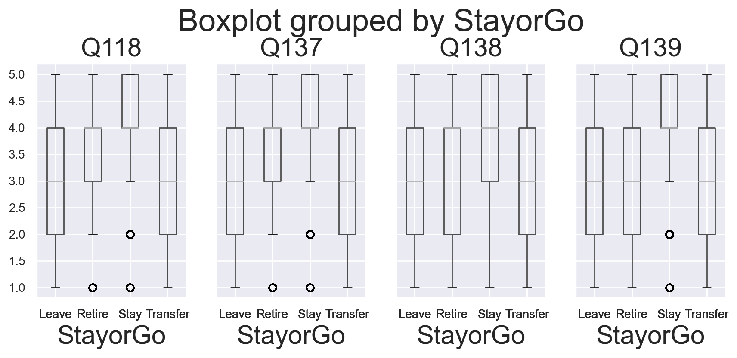
In early EDA, we also found “Leave” to be correlated with low Global Satisfaction Index (GSI) scores
Computation and Analysis
Those answering “Leave” rated answers to the GSI questions lowest of all.
Leave and Transfer answered similarly on GSI questions, but Stay responses looked dramatically different.
Q118 = I recommend my organization as a good place to work.
Q137 = Considering everything, how satisfied are you with your job? Q138 = Considering everything, how satisfied are you with your pay? Q139 = Considering everything, how satisfied are you with your organization?

Slide 19
Computation and Analysis
Before we could start with Machine Learning
we still needed to transform our data

Slide 20
Back to Data Wrangling…
Notes:
Jennifer
Although we had our columns straight in our CSV files the underlying data was not yet in a form that we could introduce into machine learning. So we need to go back to wrangling

Slide 21
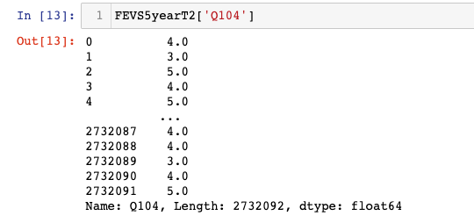
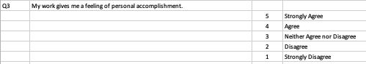
Data Wrangling
1. Some of the data were already numeric (no transformation required)
Notes:
Thankfully, some of our data were already in numeric form and no transformation was required. So here's an example of a 5-item Likert scale question where the responses were recorded in numeric form.

Slide 22
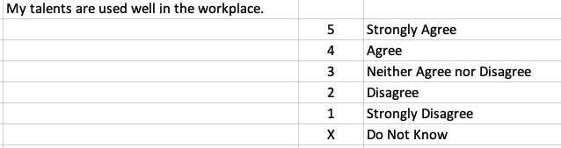
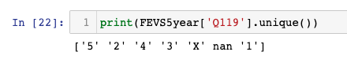
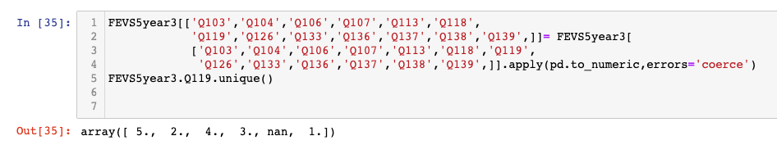
Data Wrangling
2. We “coerced” almost-numeric data to numeric using Pandas
Q119=
Notes:
However many of the Likert scale questions also contained the option "do not know" which introduced the letter "X" into our data. This automatically caused Pandas to read this field as a string. To address this, we needed to coerce this field into numeric form using pandas. After that, Xs became NaNs, or Not a Number, and this field became recognized as numeric.

Slide 23
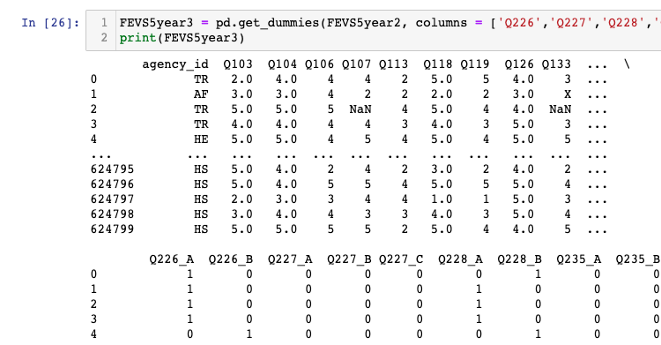
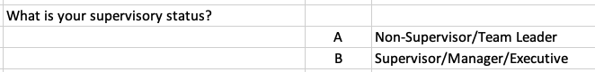
Data Wrangling
3. We used OneHotEncoding to convert categorical data to binary
Q226=
Notes:
Answers to demographic questions were captured as categorical data with labels like A or B. We need to use one hot encoding to convert these categorical data to binary. For example question 226 asked about supervisory status. In Pandas, after calling "get dummies" on our dataframe, question 226 became 226A and 226B with zeros and ones to indicate a present or not present.

Slide 24
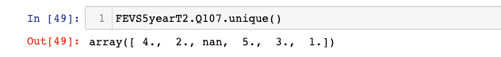
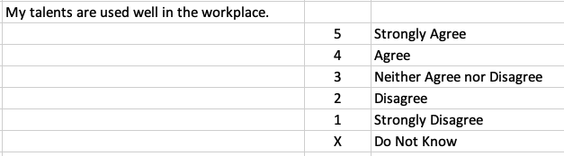
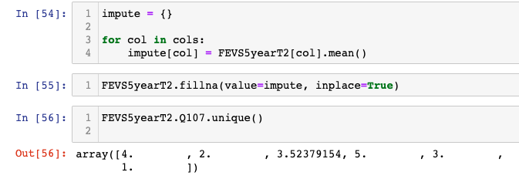
Data Wrangling
4. We imputed NaN using the column mean
Q107=
Notes:
As I mentioned before, because we decided to keep all questions from all years ~even though they weren't asked every year ~ we had a lot of null values in our data set. Additionally, coercing strings to numbers resulted in a lot of null values in our data set. But before going into machine learning we needed to transform these NaNs to numbers in some way. For Likert a scale questions that contained "do not know" we decided to impute NaN using the column mean for that question. Here's an example for question 107 which was 'my talents are used well in the workplace.' After we coerced question 107's Xs to NaN's, we then imputed the column mean which was 3.5, such that all NaNs in that column were replaced with the mean value of 3.5.

Slide 25
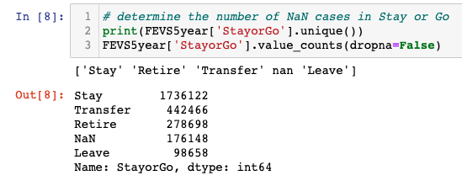
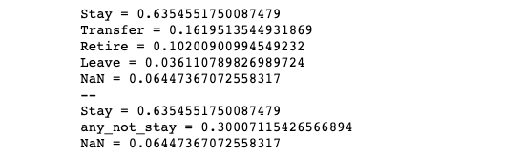
Data Wrangling
5. We observed a class imbalance for “Leave” . . .
3.6%
Notes:
Looking at our target variable, we noticed a class imbalance for "Leave." As we mentioned before we calculated this to be 3.6% across all years. This was the lowest frequency of all of the options including NaN.

Slide 26
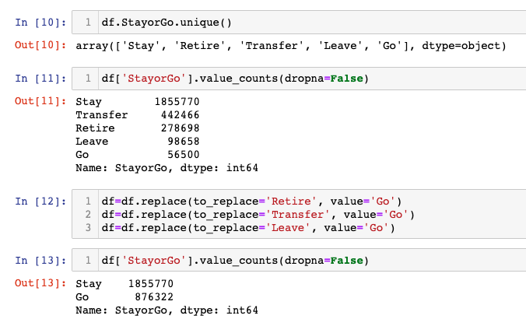
Data Wrangling
. . . So we transformed StayorGo to binary (‘Stay’, ‘Go’) and filled NaNs proportionally
Notes:
So we decided to transform Stay or Go to binary where we had two options stay or go. Any option other than stay was put into the "Go" category: These included "retire," "transfer," and "leave." Then for the NaN values, we filled those proportionally. On the previous slide you saw that Stay comprised about 63% of the data set, and so we tried to maintain that proportion for Stay in the final frequencies for Stay and Go.

Slide 27
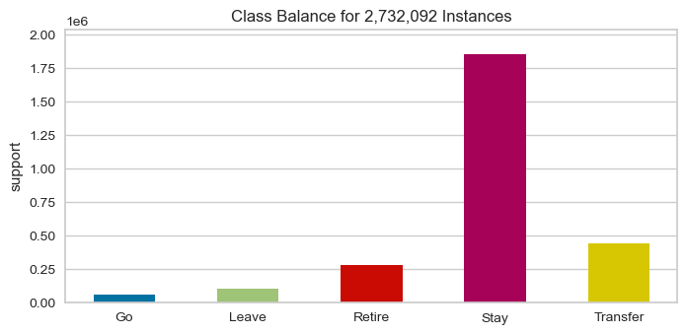
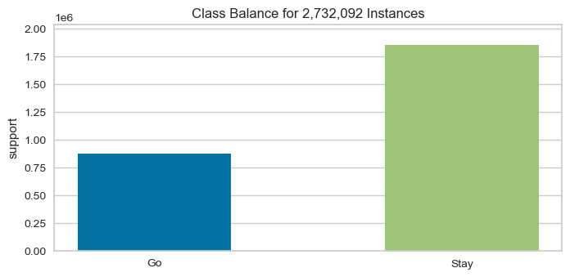
Data Wrangling
This resulted in better balanced classes going into Machine Learning
Multi Class
Binary
Notes:
As you can see, turning Stay and Go into a binary resulted in a better balance of classes going into machine learning.

Slide 28
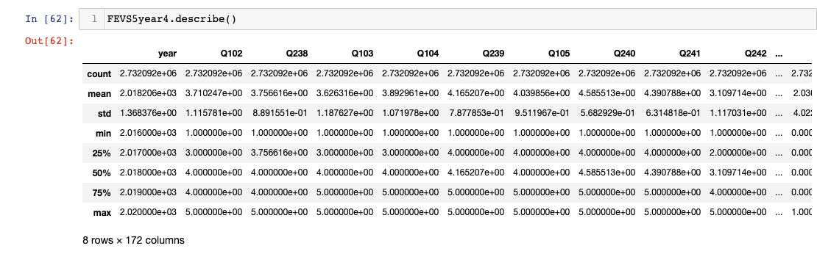
Data Wrangling
6. Finally, we dropped an additional 29 non-relevant columns, and entered ML with a 171 feature numeric dataframe
Notes:
After one hot coding our demographics variables we had way more columns than 189 and so we started to panic a little bit going into machine learning. We went back and looked very closely at the questions that were asked across all years and decided to discard an additional 29 questions that were not very generalizable to the entire data set. These were questions that were very idiosyncratic for a specific year such as employee experience with a certain HR policy during the shut down, for example. So after we dropped those 29 columns we entered machine learning with a data frame that had 171 features plus our target column of Stay or Go.

Slide 29
Modeling and Feature Selection
Notes:
Now Joy will talk about the model families that we chose and how we did feature selection and analysis

Slide 30
We evaluated five model families with Binary Classification Algorithms
Modeling and Feature Selection
Naive Bayes
Multinomial NB ()
Gaussian NB ()
Support Vector Classifier
SVC (gamma='auto’)
Nu SVC (gamma='auto'),
Linear SVC()
Logistic Regression
Logistic Regression (solver='lbfgs’)
Logistic Regression CV (cv=3)
K-Nearest Neighbors
K Neighbors Classifier()
Ensemble Classifiers
SGD Classifier (max_iter = 100, tol=1e-3)
Bagging Classifier()
Extra Trees Classifier (n_estimators = 100),
Random Forest Classifier (n_estimators = 100)

Slide 31
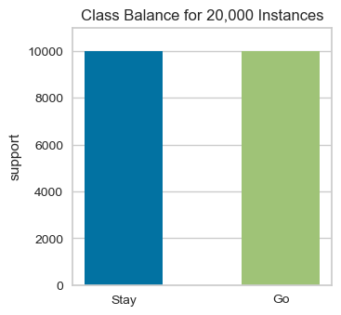
We initially sampled 20,000 cases from the data
Modeling and Feature Selection

Slide 32
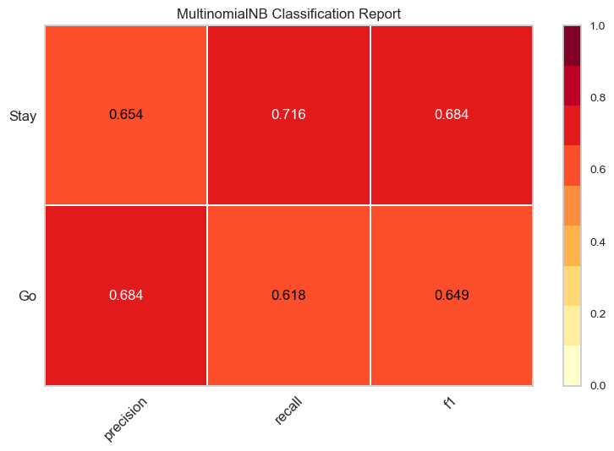
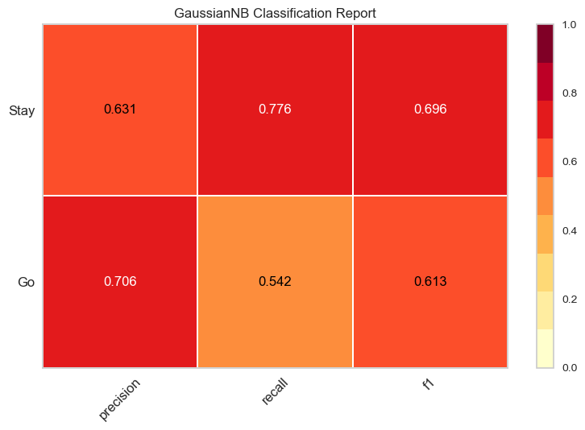
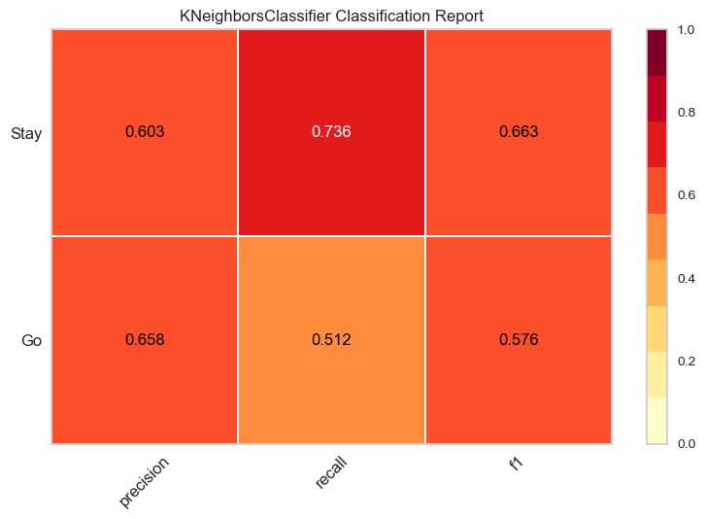


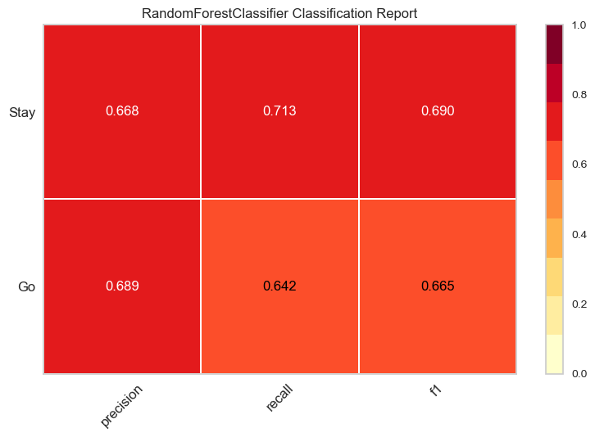

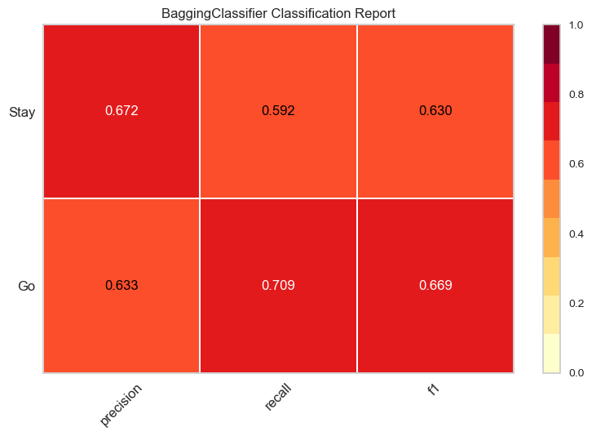
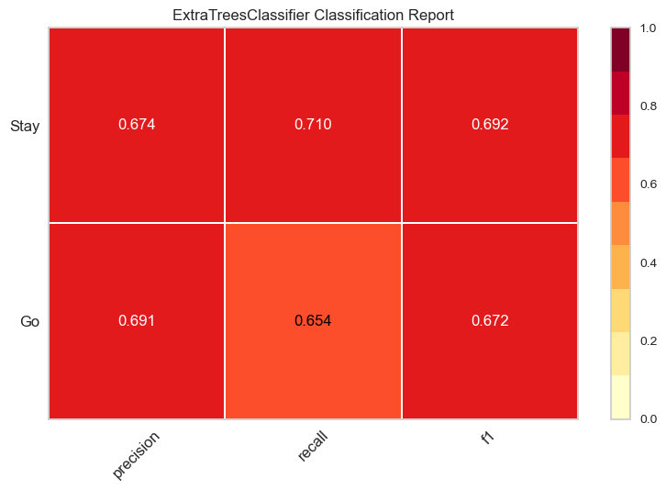

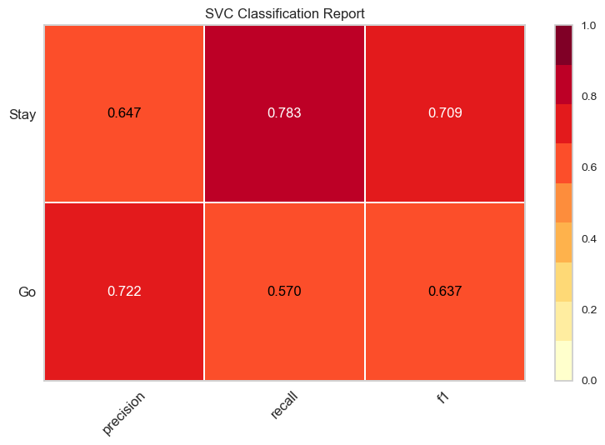

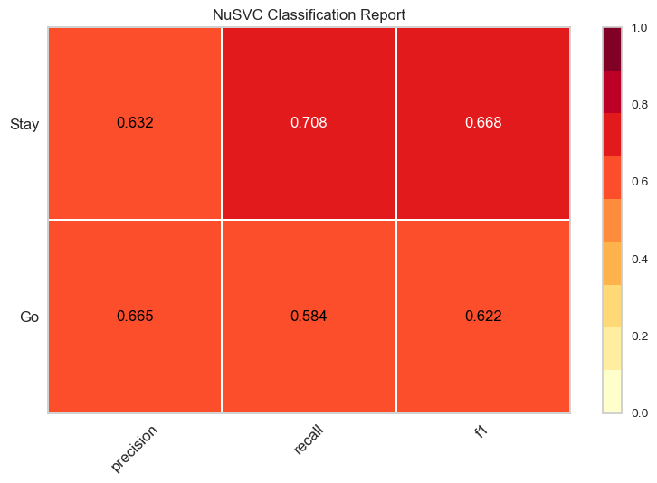

Modeling and Feature Selection
Multinomial NB
Gaussian NB
K Neighbors Classifier
Logistic Regression CV (cv=3)
We examined Classification Reports to compare “Go” Recall Scores and F1 Scores
0.618
0.649
0.542
0.613
0.512
0.576
0.613
0.659
Random Forest Classifier
Logistic Regression
Bagging Classifier
Extra Trees Classifier
0.642
0.665
0.610
0.657
0.709
0.669
0.654
0.672
SGD Classifier
SVC
Linear SVC
NuSVC
Go
0.603
0.649
0.570
0.637
0.608
0.657
0.584
0.622
Recall
F1

Slide 33
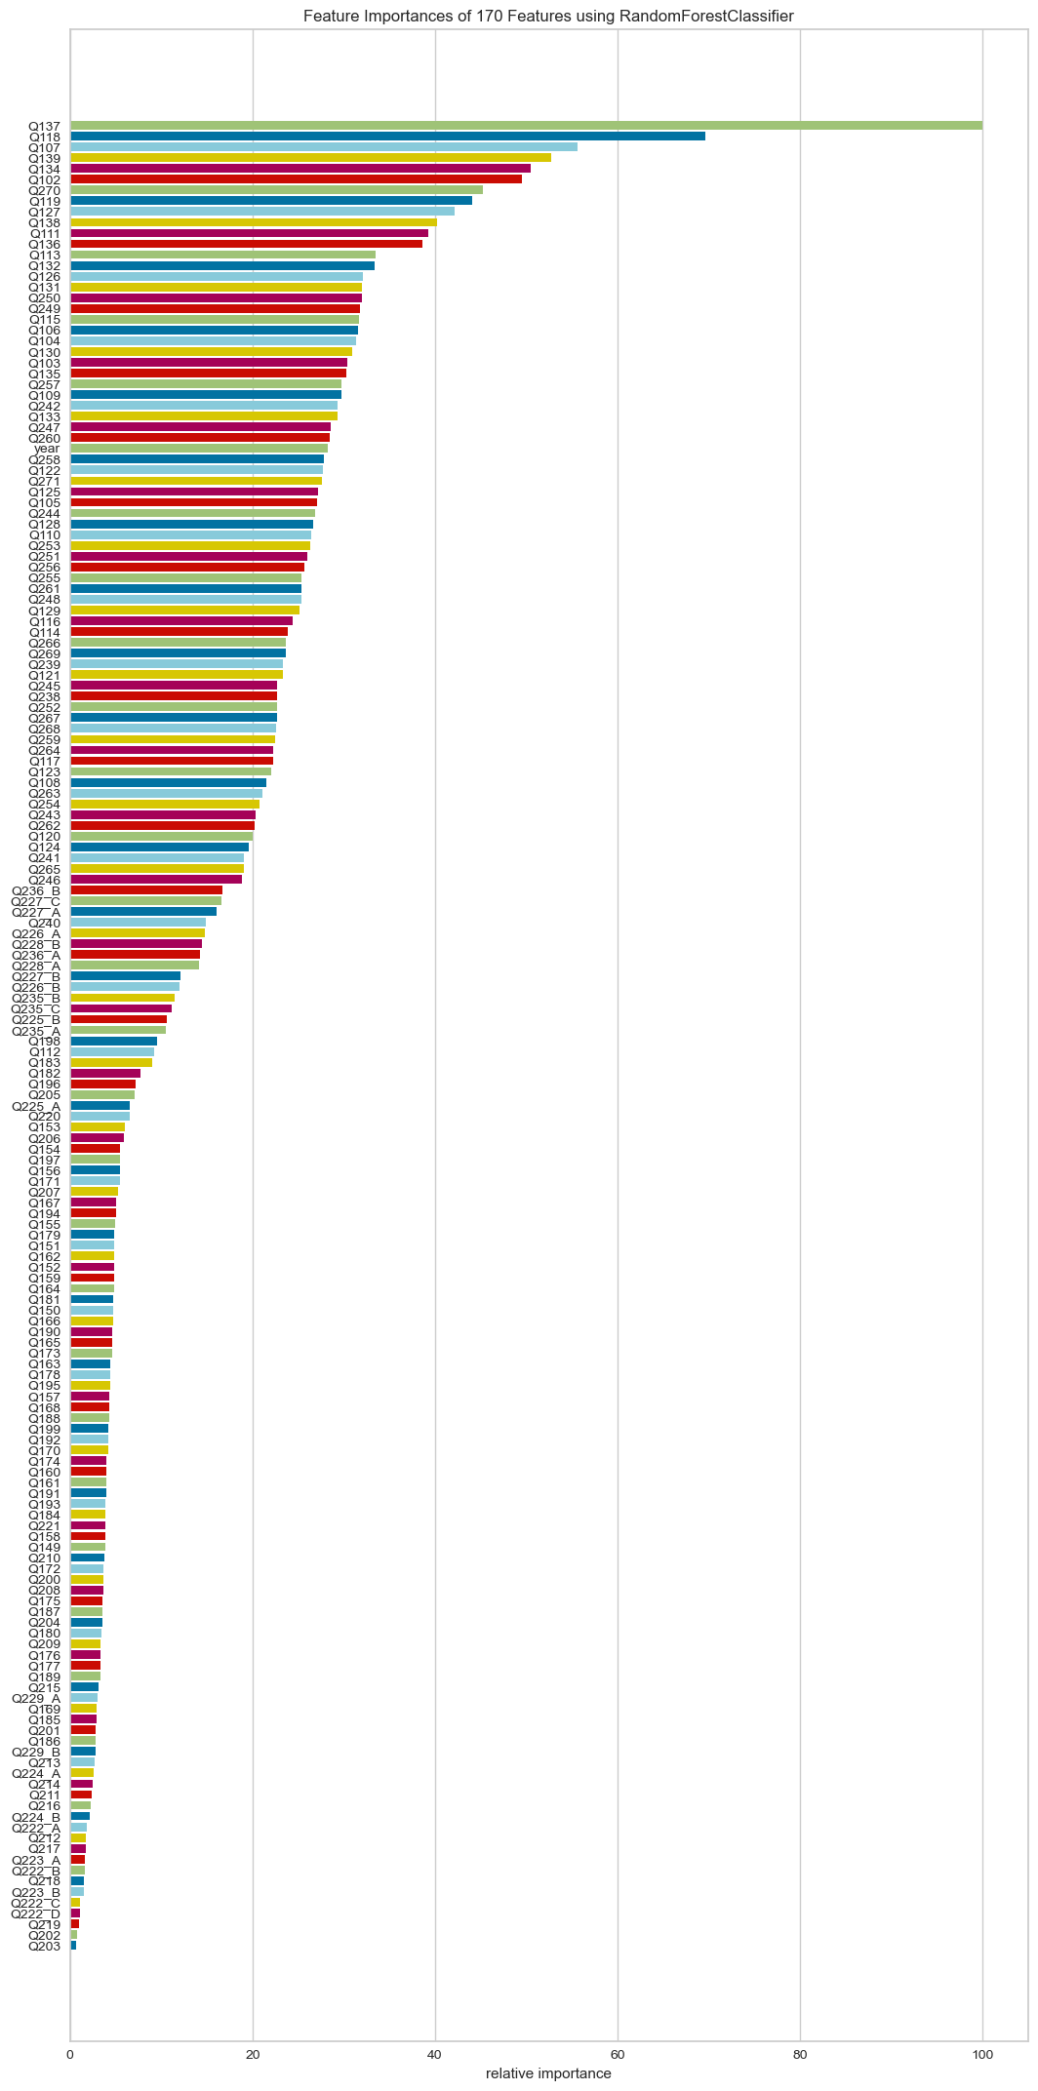
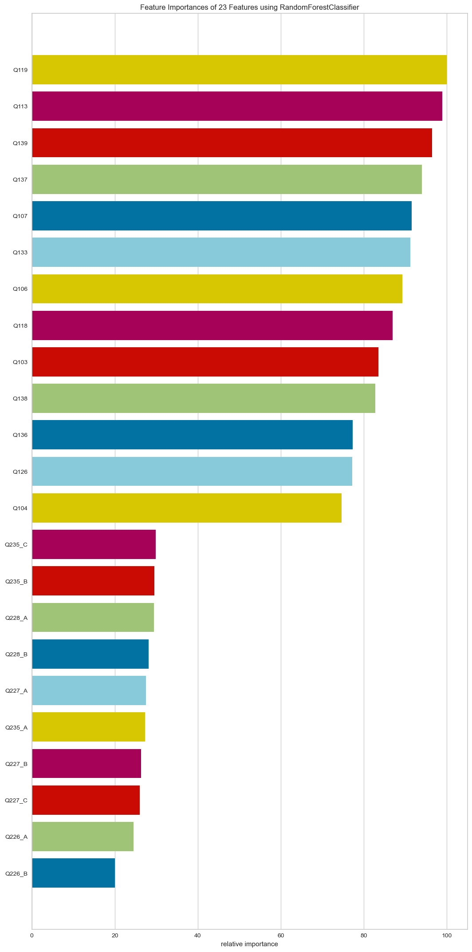
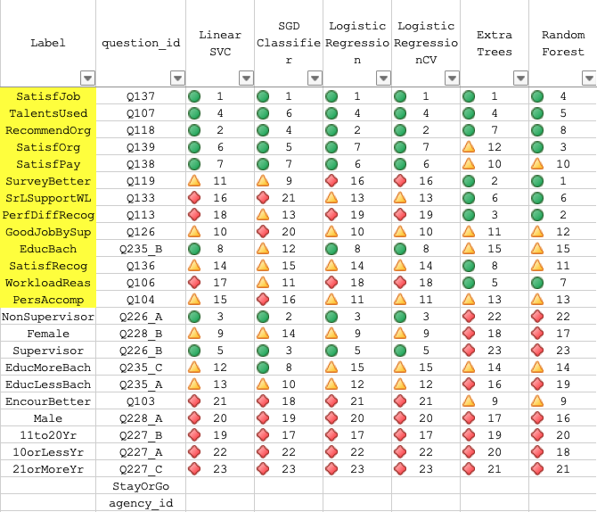
Modeling and Feature Selection
We gave stronger models
more weight in feature reduction
Before
After

Slide 34
We reduced features from 171 to 17 through four iterations
Large
171 features
Medium
98 features
Tiny
28 features
Tiny "2"
17 features
Small
60 features Indexes/ Demo
Modeling and Feature Selection
√
X
(Ask us about this detour)

Slide 35
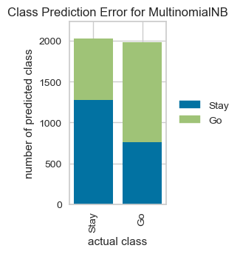
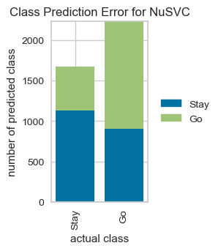
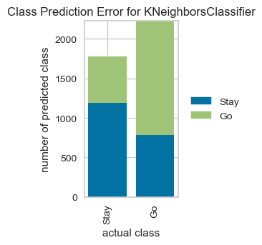
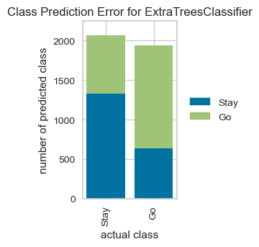
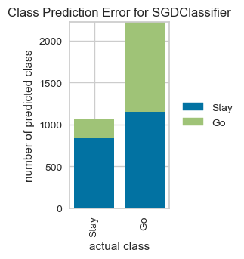
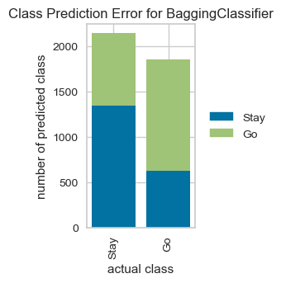

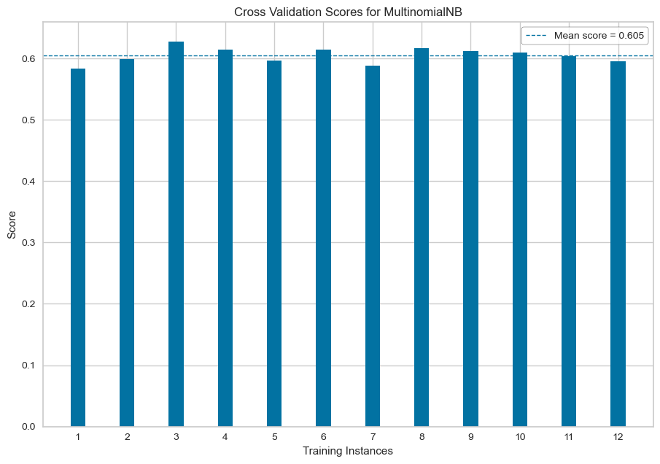















We compared Class Prediction Errors and Cross Validation Scores
Modeling and Feature Selection
ClassPredictionError()
KNeighbors Classifier
Extra Trees Classifier
Multinomial NB
NuSVC
SGD Classifier
Bagging Classifier
Mean score=0.605
Mean score=0.646
Mean score=0.635
Mean score=0.664
Mean score=0.542
Mean score=0.634
SVC
Random Forest Classifier
Linear SVC
Logistic Regression CV
Logistic Regression
StratifiedKFold(K=12)
scoring='f1_weighted'
Mean score=0.687
Mean score=0.687
Mean score=0.686
Mean score=0.672
Mean score=0.662

Slide 36











We examined confusion matrices to compare the models’ abilities to accurately predict “GO”
Modeling and Feature Selection
SVC
SGD
Linear SVC
1660
1598
1567
Logistic Regression
Logistic Regression CV
Multinomial NB
True Class | Stay | True Positives | False Positives
 | GO | False Negatives | True Negatives
 |  | Stay | GO
Predicted Class |  | Predicted Class
1557
1541
1501
KNeighbors Classifier
NuSVC
Extra Trees Classifier
1433
1408
1355
Random Forest Classifier
Bagging Classifier
1393
1197

Slide 37
Two models performed strongest: Linear SVC and SVC
Modeling and Feature Selection
Linear SVC
SVC
SVC
Linear SVC
1660
1567
SVC, or Support Vector Classifier, is a supervised machine learning algorithm typically used for classification tasks. SVC works by mapping data points to a high-dimensional space and then finding the optimal hyperplane that divides the data into two classes.
Mean score=0.662
Mean score=0.686
Notes:
Higher F1 score, best performance, lower errors compared to others

Slide 38
Reporting and Visualization
Linear SVC as Our Ideal Model

Slide 39









Reporting and Visualization
Linear SVC
Data Sampled
Classification Reports
Feature Importances
100,000 rows
Go Recall: 0.625
0.625
0.672
200,000 rows
Go Recall: 0.624
0.624
0.670
Go Recall: 0.560
1,800,000 rows
0.560
0.624

Slide 40
Reporting and Visualization
Sample Size: 1.8M
Notes:
How did we go from 17 to 23 features? We had 13 core questions plus + 4 demographic variables that were one hot encoded for a total of 23 columns.
There are some demographic variables in our final results, but we want to focus on the 13 non-demographic variables in our conclusion.
1. Because demographics were label enocoded (binary) before ML, only one “option” for a demographic question (e.g., “227B”) was ranked in feature importances, yet when we did the next iteration with reduced features through the model, we included all answers for that question (e.g., A, B, C). I was fearful of one option being overrepresented; however, in hindsight we may have oversampled demographic questions in our final feature set when demographics really aren’t that impactful.
2. None of the indexes include demographic questions, so demographics are not important for our secondary goal of evaluating the predictive nature of the Indexes for stay or go.

Slide 41
Back to Computation and Analysis…
Notes:
Now that we identified the top features that could predict "stay or go," we went back to data analysis to take a closer look at the relationship between these factors and intent to leave.

Slide 42



Computation and Analysis
Employees who rate low on Global Satisfaction questions are more likely to indicate GO
GSI, AES
GSI, AES
GSI, AES
GSI only
(All 4 GSI Questions, n = 2.7M)
Notes:
At the top of our list of feature importances were the four questions that make up the global satisfaction index: job satisfaction, satisfaction with one's pay, satisfaction with one's organization, and whether an employee recommends their agency as a good place to work. Those who answered more 1s, 2s, and 3s, proportionally, on these questions are those who are more likely to express intent to Go. Looking at the graph that extra column is the NaNs that were filled with the mean of the column.
There are 4 total GSI questions.
Our features had a total of 4 GSI questions (100%) in our top 13 (in our top 8, in fact). (Adam: this is key)

Slide 43


Computation and Analysis
Eight out of 16 AES* questions contribute to our ML model in predicting intent to say GO
My talents are used well in the workplace
I believe the results of this survey will be used to make my agency a better place to work.
In my unit, differences in performance are recognized in a meaningful way.
How satisfied are you with the recognition you receive for doing a good job?
My workload is reasonable.
*AES = Annual Employee Survey mandated by Congress
Notes:
Also high on our feature importances are 8, or half of, the 16 questions that comprise the congressional mandated annual employee survey or AES.
Three of these overlap with the GSI.
Additional unique ones here include questions about talents, recognition, workload, and even whether this survey will have an impact

Slide 44


Computation and Analysis
Individuals who score low on certain other factors are likely to indicate GO
Overall, how good a job do you feel is being done by your immediate supervisor?
My work gives me a feeling of personal accomplishment
I feel encouraged to come up with new and better ways of doing things.
Notes:
Three additional questions appeared in our top features, having to do with one's rating of their supervisor, feeling accomplished at work, and being encouraged to innovate. Again, employees who selected stay and those who indicated go may have answered all five options, but those who expressed intent to Go selected 1s, 2s, and 3s more often than those who indicated Stay.

Slide 45

One’s Supervisor status does not seem to play a critical role in predicting GO or Stay
Computation and Analysis
Notes:
When we looked at the demographic variables we did not necessarily see that supervisor status, for example, played a critical role in predicting intent to stay or go.

Slide 46

Education may or may not contribute to whether employee will choose GO or Stay
Computation and Analysis
Notes:
Similarly, we did not see that education level contributed all that much to one's selection of Stay or Go.

Slide 47
Project Results
Reporting and Visualization
Primary:
Use Machine Learning to analyze the FEVS and identify the factors that predict an employee choosing “Leave” on the Intent to Leave Question
Initial Hypothesis: By analyzing the FEVS data using Machine Learning, we will identify the factors that can predict someone answering “Yes, to take another job outside the Federal Government” to this question (i.e., “Leave”).
Outcome: Yes, by analyzing the FEVS data using Machine Learning, we identified the most important factors that can predict an employee’s intent to leave.
Notes:
Reflecting now on our primary project goal we think we can say that yes by analyzing the FEVS data using machine learning we were able to identify the most important factors that can predict an employees intent to leave.

Slide 48
Project Results
Reporting and Visualization
Secondary:
Validate (clarify/debunk) any assumed relationship between the Indexes and answers on Intent to Leave question
Validated GSI (100%) and (AES 50%) as predictors of Intent to Leave
No support for EEI’s presumed relationship to Intent to Leave
Develop a Web Survey or App that could allow federal managers to predict workforce availability (sooner), or even intervene
(Not started)
Notes:
We were also able to validate the Global Satisfaction Index as a good predictor of intent to leave, as 100% of those questions showed up at the top of our feature importances. Additionally, half of the questions that are supposed to be included in the Annual Employee Survey can also be good predictors of intent to leave. On the other hand, we found no support for the Employee Engagement Index's ability to predict intent to leave.
As for developing a web survey or an app we did run out of time before being able to entertain the possibility but we still think it would be a good idea to try

Slide 49
Practical Application
Reporting and Visualization
Best options for for predicting whether employees will say they intend to leave:
Global Satisfaction Index and the answers to all 4 questions
Answers to 8 out of the 16 Annual Employee Survey (AES) questions
The Employee Engagement Index (EEI) is not as useful for predicting intent to leave
Only four of the 15 questions made it into our top 13, and even those were in our bottom 8.
Notes:
In terms of the very practical application that we were seeking from this project we would recommend to the OPM that the best options for predicting whether employees will say they intend to leave are the Global Satisfaction Index and the answers to all four of those questions, and also answers to eight out of the 16 Annual Employee Survey questions. We would also recommend that the Employee Engagement Index is not as useful for predicting Intent To Leave as only four of the EEI questions made it into our top 13, and even those were in our bottom eight.

Slide 50
Limitations
Reporting and Visualization
Worked with sampled data
Up to 1.8M/2.7M rows
Collapsing StayorGo to binary might have diluted our focus “Leave”
“Not-Stay” may need to be compared to a different turnover metric (e.g., Total Separations)
Results are valid for federal government as a whole
We did not use weighting factors supplied in the Codebooks to break out results for individual agencies
Notes:
As with any project, there are limitations to our claims. First, we acknowledge that due to processing power we worked primarily with sample data. However, as Joy showed the scores did not necessarily improve as we increased the sample size.
By including Retire and Transfer with Leave in Go, we may have diluted the data such that the "Quits" rete might not be the right comparative metric. We might need to compare our results to something more like "total separations."
Finally, we did not use a weighting variable that adjusted for agency size and response rates, so our conclusions are really only generalizable to the federal government as a whole.

Slide 51
Future Opportunities
Reporting and Visualization
Analyze additional “Leave” questions asked during:
Shutdown in 2019
Covid in 2020
Use the weighting variables to compare results across different agencies
Notes:
We could work with that weighting variable in the future to break out results by agency.
We could also take a closer look at questions about leaving that were asked specifically with respect to the Shutdown in 2019 and the Pandemic in 2020.

Slide 52
Lessons Learned
Reporting and Visualization
Related to Project Goals
Try harder to obtain the raw data set to view finer demographics
Setting up a SQL database was a good experience but we didn’t really use it
Related to Data Science
Data wrangling takes longer than we expected
Data balance impacts Machine Learning model performance
Feature selection and analysis are iterative with Machine Learning
To evaluate a Machine Learning model, multiple factors need to be considered (e.g., F1 scores, cross validation scores, confusion matrices, etc.)
Data Science is a community: Ask for help, Google it, and rely on your colleagues and instructors for help
Notes:
Reflecting on the project as a whole, Joy and I learned a few lessons we'd like to share. First, there were more demographic questions asked, and answer options give, that were somewhat aggregated in the data set. We might try harder in the future to obtain the raw data set. Second, as I mentioned, we appreciated learning about SQL and Snowflake and so we might like to work on a project in the future that uses a database more extensively for querying.
Joy will cover lessons we learned about data science in general.

Slide 53


Great to meet you all! Please STAY in touch!
XBUS-500
XBUS-507

Slide 54
Questions?
Notes:
We'll be happy to take any questions that you have.

Slide 55
Slide 1
Idea and Inspiration
Data Ingestion and Wrangling
Computation and Analysis
Modeling and Feature Selection
Reporting and Visualization
Conclusion and Q&A
Thank you to Adam, Daniel, our classmates, and all of our Cohort 27 faculty!
Chuanfeng “Joy” Wu
Jennifer Ziegler
Georgetown University Data Science Certificate Cohort 27
September 24, 2022
Notes:
Thanks!

Slide 57
Appendix Additional Slides if Needed for Discussion

Slide 58
Feature Importances Questions by Index
AES
AES |  | GSI |  |  | SatisfJob | 1 | Considering everything, how satisfied are you with your job? 5 = Very Satisfied … 1 = Very Dissatisfied
AES |  | GSI |  |  | RecommendOrg | 2 | I recommend my organization as a good place to work. 5 = Strongly Agree … 1 = Strongly Disagree
AES |  | GSI |  |  | SatisfOrg | 3 | Considering everything, how satisfied are you with your organization? 5 = Very Satisfied … 1 = Very Dissatisfied
AES | IWE |  | EMPO |  | TalentsUsed | 5 | My talents are used well in the workplace. 5 = Strongly Agree … 1 = Strongly Disagree; X = Do Not Know
AES |  |  |  |  | WorkloadReas | 14 | My workload is reasonable. 5 = Strongly Agree … 1 = Strongly Disagree; X = Do Not Know
AES |  |  |  |  | SurveyBetter | 16 | I believe the results of this survey will be used to make my agency a better place to work. 5 = Strongly Agree … 1 = Strongly Disagree; X = Do Not Know
AES |  |  |  |  | SatisfRecog | 17 | How satisfied are you with the recognition you receive for doing a good job? 5 = Very Satisfied … 1 = Very Dissatisfied
AES |  |  | FAIR |  | PerfDiffRecog | 18 | In my work unit, differences in performance are recognized in a meaningful way. 5 = Strongly Agree … 1 = Strongly Disagree; X = Do Not Know
 | (EEI)
AES | IWE |  | EMPO |  | TalentsUsed | 5 | My talents are used well in the workplace. 5 = Strongly Agree … 1 = Strongly Disagree; X = Do Not Know
 | SUPE |  |  |  | GoodJobBySup | 11 | Overall, how good a job do you feel is being done by your immediate supervisor? 5 = Very Good … 1 = Very Poor
 | IWE |  |  |  | PersAccomp | 13 | My work gives me a feeling of personal accomplishment. 5 = Strongly Agree … 1 = Strongly Disagree
 | IWE |  | EMPO |  | EncourBetter | 20 | I feel encouraged to come up with new and better ways of doing things. 5 = Strongly Agree … 1 = Strongly Disagree
 |  | GSI
AES |  | GSI |  |  | SatisfJob | 1 | Considering everything, how satisfied are you with your job? 5 = Very Satisfied … 1 = Very Dissatisfied
AES |  | GSI |  |  | RecommendOrg | 2 | I recommend my organization as a good place to work. 5 = Strongly Agree … 1 = Strongly Disagree
AES |  | GSI |  |  | SatisfOrg | 3 | Considering everything, how satisfied are you with your organization? 5 = Very Satisfied … 1 = Very Dissatisfied
 |  | GSI |  |  | SatisfPay | 8 | Considering everything, how satisfied are you with your pay? 5 = Very Satisfied … 1 = Very Dissatisfied
 |  |  | (NIQ)
AES | IWE |  | EMPO |  | TalentsUsed | 5 | My talents are used well in the workplace. 5 = Strongly Agree … 1 = Strongly Disagree; X = Do Not Know
AES |  |  | FAIR |  | PerfDiffRecog | 18 | In my work unit, differences in performance are recognized in a meaningful way. 5 = Strongly Agree … 1 = Strongly Disagree; X = Do Not Know
 | IWE |  | EMPO |  | EncourBetter | 20 | I feel encouraged to come up with new and better ways of doing things. 5 = Strongly Agree … 1 = Strongly Disagree

Slide 59
The Entire EEI – the original 15 questions (with the 4 reflected in Feature Importances in bold)
I feel encouraged to come up with new and better ways of doing things.
My work gives me a feeling of personal accomplishment.
I know what is expected of me on the job.
My talents are used well in the workplace.
I know how my work relates to the agency's goals.
In my organization, senior leaders generate high levels of motivation and commitment in the workforce.
My organization's senior leaders maintain high standards of honesty and integrity.
Managers communicate the goals of the organization.
Overall, how good a job do you feel is being done by the manager directly above your immediate supervisor?
I have a high level of respect for my organization's senior leaders.
Supervisors in my work unit support employee development.
My supervisor listens to what I have to say.
My supervisor treats me with respect.
I have trust and confidence in my supervisor.
Overall, how good a job do you feel is being done by your immediate supervisor?

Slide 60
The entire AES – the original 16 questions (with the 8 reflected in feature importances in bold)
Considering everything, how satisfied are you with your job? 5 = Very Satisfied … 1 = Very Dissatisfied
I recommend my organization as a good place to work. 5 = Strongly Agree … 1 = Strongly Disagree
My talents are used well in the workplace. 5 = Strongly Agree … 1 = Strongly Disagree; X = Do Not Know
Considering everything, how satisfied are you with your organization? 5 = Very Satisfied … 1 = Very Dissatisfied
I believe the results of this survey will be used to make my agency a better place to work. 5 = Strongly Agree … 1 = Strongly Disagree; X = Do Not Know
I am given a real opportunity to improve my skills in my organization. 5 = Strongly Agree … 1 = Strongly Disagree
How satisfied are you with your involvement in decisions that affect your work? 5 = Very Satisfied … 1 = Very Dissatisfied
How satisfied are you with the recognition you receive for doing a good job? 5 = Very Satisfied … 1 = Very Dissatisfied
The people I work with cooperate to get the job done. 5 = Strongly Agree … 1 = Strongly Disagree
My workload is reasonable. 5 = Strongly Agree … 1 = Strongly Disagree; X = Do Not Know
How satisfied are you with the information you receive from management on what's going on in your organization? 5 = Very Satisfied … 1 = Very Dissatisfied
I can disclose a suspected violation of any law, rule or regulation without fear of reprisal. 5 = Strongly Agree … 1 = Strongly Disagree; X = Do Not Know
In my work unit, differences in performance are recognized in a meaningful way. 5 = Strongly Agree … 1 = Strongly Disagree; X = Do Not Know
Managers communicate the goals of the organization. 5 = Strongly Agree … 1 = Strongly Disagree; X = Do Not Know
My work unit has the job-relevant knowledge and skills necessary to accomplish organizational goals. 5 = Strongly Agree … 1 = Strongly Disagree; X = Do Not Know
I know how my work relates to the agency's goals. 5 = Strongly Agree … 1 = Strongly Disagree; X = Do Not Know

Slide 61


Misc. Questions n=2.7M not in any other index except EEI (3Q); see next
Computation and Analysis

Slide 62
Only four out of 15 EEI questions made it into our top 13 n=2.7M
Computation and Analysis
There are 15 total EEI questions.
Our features had a total of 4 AES questions (27%) in our top 13; none in the top four.
Yet the only reporting on the Stay or Go question during the time period for our survey was in terms of how it correlated with EEI.
(This changed in 2021 when OPM compared Leave to GSI scores.)
Notes:
The graphs at the bottom looks similar to the other distributions, so I could see why comparing EEI and Leave would have good face validity. But most of the 15 EEI features were not in our top 13. In fact, only four got picked up, and they were in our bottom 8. EEI might be valid to measure for other reasons (like, whether employees are engaged) but if you actually want to be able to predict if people are going to leave, then you need to look at other factors.

Slide 63

Supervisor vs. Non-Supervisor n=2.7M
Computation and Analysis
Notes:
Adam: non-supervisors (not supervisors) are more likely to answer go and that supervisors and non-supervisors are staying.
Jennifer: I still don’t get this, even when I scale the chart.

Slide 64

Education Levels n= 2.7M
Computation and Analysis
Notes:
Adam: I'll take a look at the notebook, I'm not sure, you might want to take this out. If these are accurate, then I see that education doesn't factor much into stay/go which would be a cool insight.
Adam: Thinking more about that education slide, I think that is the way it falls more educated are more likely to go. An interesting finding.

Slide 65
Other Questions in AES, n= 2.7M
Computation and Analysis
There are 16 total AES questions.
Our features had a total of 8 AES questions (50%) in our top 13.
Notes:
Adam: This is a feature selection/EDA slide. Interesting insight. When you're talking about it highlight the features and how it contrasts with the features on the previous slide.
We’re calling this out because these were five other questions in the required annual employee survey. With three out of the four from the previous slide and these five, these eight slides are half of the 16 Congress mandated questions for federal employees. OPM probably needs to keep the other eight to measure other outcomes, but these eight will give you a good sense of intended workforce churn.

Slide 66



Computation and Analysis
These 8 questions might indicate someone who is ready to say they’re going to leave. The other questions might be interesting to ask for other reasons, but they won’t necessarily predict exit.
AES = 16 Congress mandated questions (must be asked every year) Trends from 2020 report
Notes:
These eight questions are half of the 16 Congress mandated questions for federal employees, and they all appeared in our top 13. OPM probably needs to keep the other eight questions to measure other things, but if you’re interested in understanding intended workforce churn, these will give you a good prediction.
(Interesting that starred questions are all “up” in 2020, signaling people less likely to express intent to leave during the pandemic. Since these are up in 2020 we should look again at actual quits in 2021 and how they trended.)

Slide 67

Computation and Analysis
GSI results 2018
GSI was up again in 2019 and 2020
Notes:
Our results suggest that if you are really interested in knowing who is going to leave, it’s a good idea to look at the questions that comprise GSI score as compared to any other index. By including Retire and Transfer, we may have diluted the data because “satisfied with your job” now has answers from 1-5 for Go. So the key is to compare the difference between Stay and Not-Stay. Every possible response was offered by people who intended to Stay and people who intended to Go. But the group who answered more 1s, 2s, and 3s, proportionally, is the group that is likely to Go. Looking at the graph that extra column is the NaNs that were filled with the mean of the column.

